Slide 1
Jaden Sequeira
Project Portfolio

Slide 2
Cardiac Phantom
September 2024 - June 2025
Sponsors: Digital Lab

Slide 3
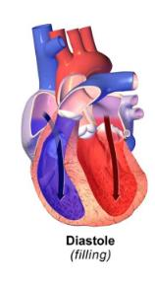
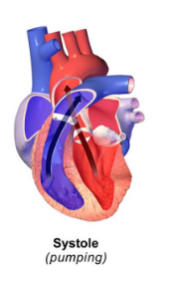
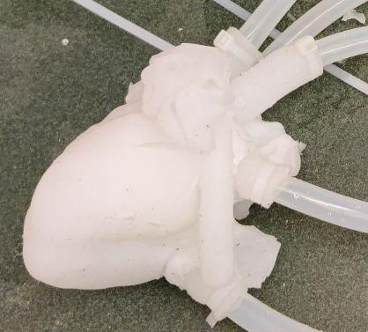



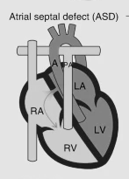
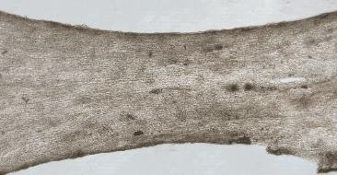
Cardiac Phantoms for Technician Training: Requirements
5. MRI Compatible
Pulsatile and Leak Proof
2. Durable (>5 hours of use)
3. Accurate Anatomy with CHD
4. Realistic Tissue Properties

Slide 4
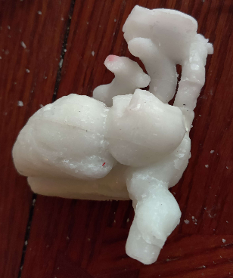
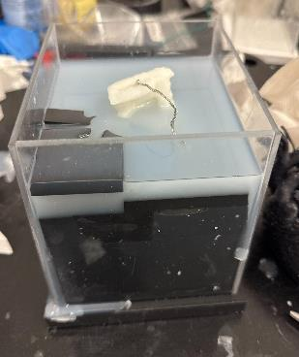
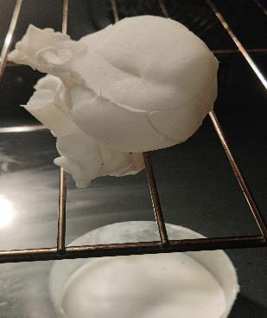
Chosen Solution: Lost Wax Casting Method with Wireframe
1) Creating Desired Wax Model
2) Casting Silicone with Wax Model
3) Melting Out Wax
Notes:
Sayeh

Slide 5
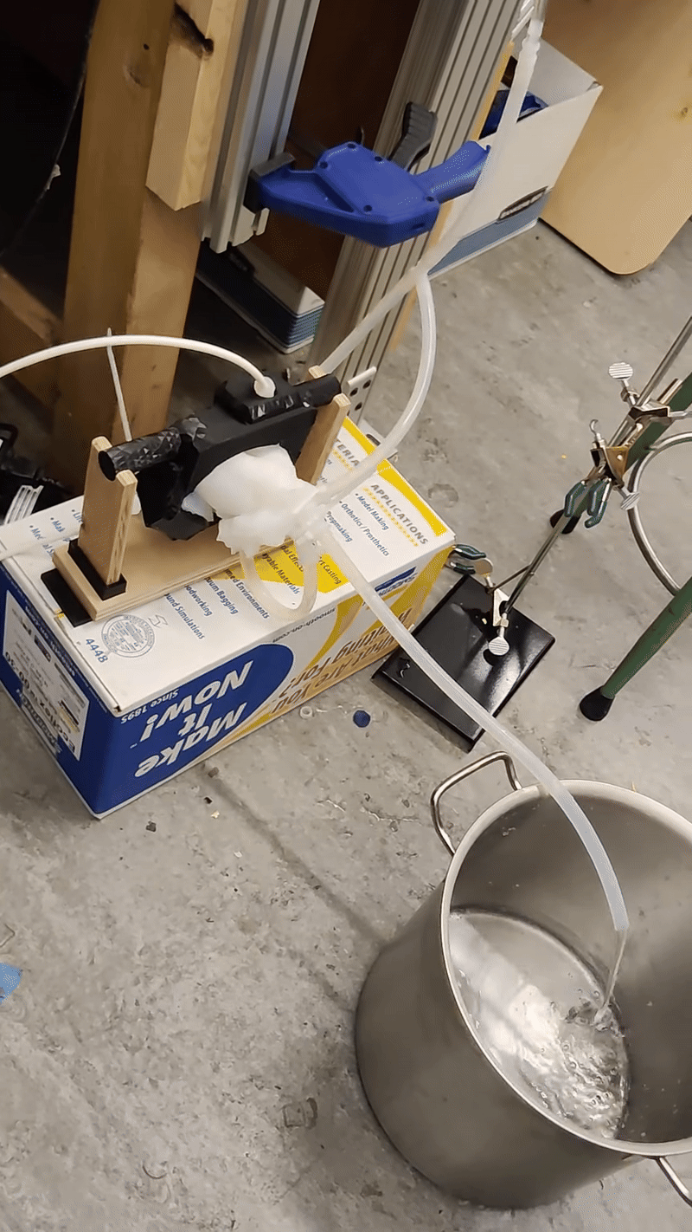
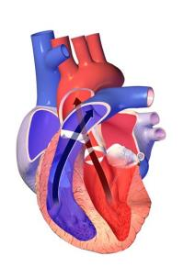
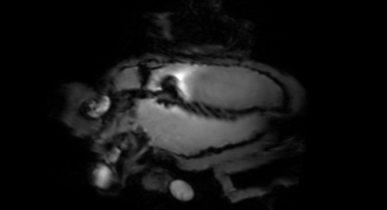
Actuation System
Water Tank
Air
Pressurized Air
Ejection
MRI Demo 1, MRI Demo 2
Left Ventricle Ejection Fraction
60% at 60 bpm
Achieved Normal Ejection
Air Compressor
Arduino
P₀
P_{a}
Pressure Regulator
P_{atm}
Solenoid Valve
Notes:
Ejection volume measurements: ejection frame=(LV ejected during contraction)/volume being filled up fraction measurements
Fixing slow filling
Address it with larger tubing and thicker actuators

Slide 6
Multiplexed Single Cell Secretion Assays
July - December 2024
Supervisor: Dr. Hongshen Ma

Slide 7
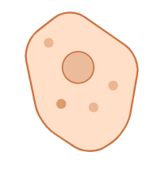
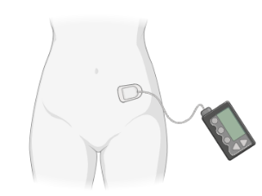


Motivation
Insulin
Type 1 Diabetes
Pancreatic Beta Cells
Insulin Injections
Treatments
Donor Beta Cells
Not Enough Donors
Beta Cell Transplants
Repurposed Stem Cells

Slide 8
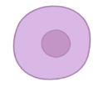


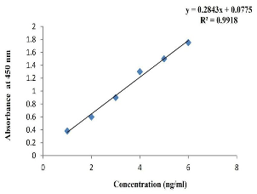
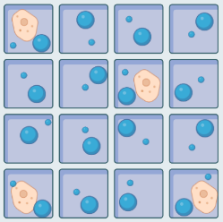

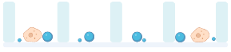
Objective
?
Insulin
Insulin
?
Glucagon
Glucagon
Stem Cell
Beta Cell
Donor Beta Cells
40 um
40 um
2.8 um
Fluorescent Intensity
Insulin Bead
Insulin Concentration
4.5 um
Microscope View
Nanowell
Fluorescent Intensity
Side View
Glucagon Bead
Glucagon Concentration
Notes:
Example image with microscope + explain brightfield vs fluorescence

Slide 9
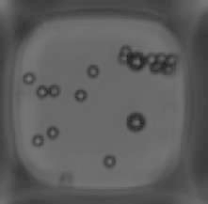
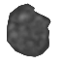
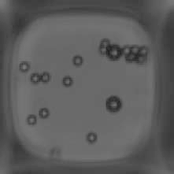
Phase 1: Machine Learning Segmentation
2.8 um Bead Mask
U-Net
Brightfield
Segmented Image
Overlay Image
2.8 um Beads
4.5 um Beads
4.5 um Bead Mask

Slide 10
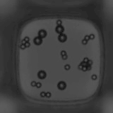


Phase 1: Results
Intersection Area
x
Input: Brightfield
2
=
Dice Score
+
Predicted Area
Expected Area
X 158
(Bad) 0 < Dice Score < 1 (Excellent)
Trained U-Net
Result N = 158 | 2.8 um Beads | 4.5 um Beads
Mean Dice Score | 0.93 | 0.95
Dice Score SD | 0.03 | 0.03
Min Dice Score | 0.77 | 0.83
X 158
X 158
Prediction
Expected Output: Ground Truth
Notes:
Fix Plus sign

Slide 11
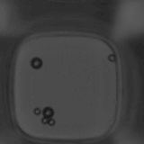
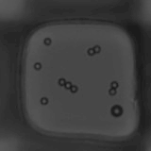
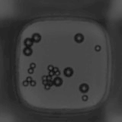
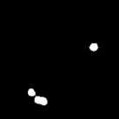
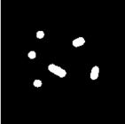
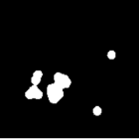
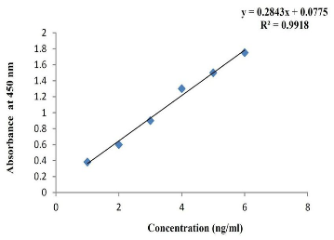
Phase 2: Fluorescent Intensity Measurement
Fluorescent Overlay
Fluorescent Overlay
Fluorescent Overlay
2 nM Insulin, 2 nM Glucagon
4 nM Insulin, 2 nM Glucagon
6 nM Insulin, 2 nM Glucagon
2.8 um Bead Mask
2.8 um Bead Mask
2.8 um Bead Mask
Fluorescent Intensity
Previous Experiments
Insulin Concentration (nMol)

Slide 12
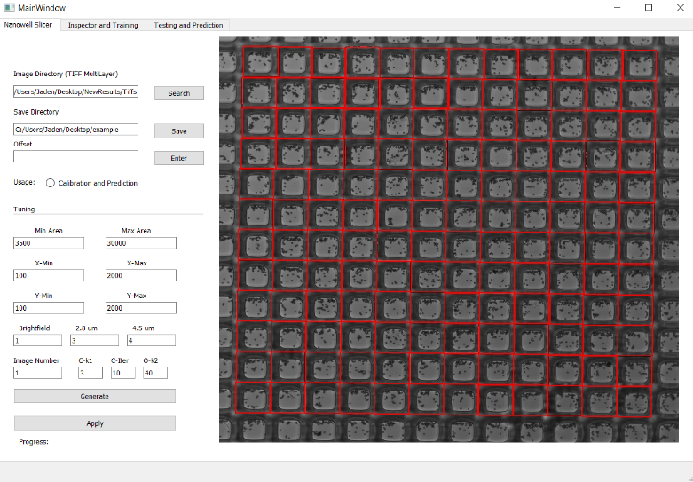
Multiplexed Bead ELISA GUI
Features:
Nanowell cropping
Auto and Manual Training Data Inspection
Training and Testing of 3 category U-Net
Segmentation and fluorescence predictions
Nanowell Image Re-stitching

Slide 13
UBC ECE Biosensors
May 2023 - December 2023
Supervisors: Dr. Samantha Grist, Dr. Karen Cheung, Dr. Sudip Shekhar

Slide 14
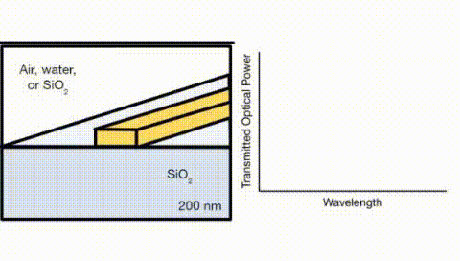
Silicon Photonic (SiP) Biosensors and Functionalization
Ring Resonator
Resonating light
Light in
Output waveguide
Input waveguide
Output
Binding of biomolecule to bioreceptor induces a change in refractive index.
This leads to a shift in the resonance frequency which can be used to determine the concentration of the biomolecule of interest.

Slide 15
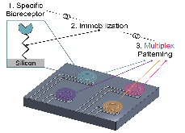
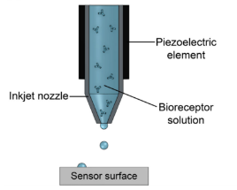
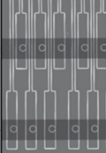
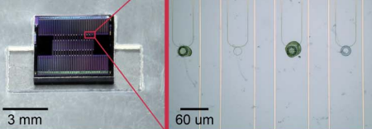
Objective
1 Biomarker Functionalization
Single Biomarker Sensor
Printing
Microfluidics
Functionalization
Sensors
Bio-Sensors
Multiplexed Biosensor
Printing
Inkjet Printer
Develop a multiplexed piezoelectric inkjet printer to accurately dispense biomolecules to pattern the ring resonators on SiP chips
x4
Puumala et al., Biosensors, 2022
Puumala et al., Biosensors, 2023
Kirk et al., Lab Chip, 2011

Slide 16

Work Roadmap
Stage 1
Stage 2
PiezoDrop GUI
Drive (AWG+Amp) System Testing
Droplet Imaging
Droplet Video Analysis
Square Array Printing
Stage Accuracy Testing
Printing Alignment Procedure
Stage 3
Multiplexing Testing
New 8 Nozzle System
System Documentation
Weekly Prints
User Friendly GUI
Fluorescence Printing
Pseudo Chip Printing
Multiplexed Inkjet Printer
Functional Inkjet Printer

Slide 17
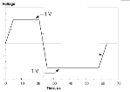
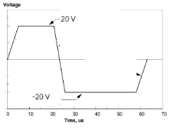
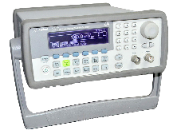
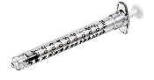
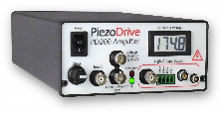
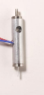
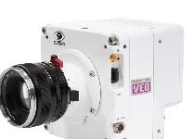


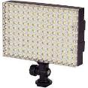
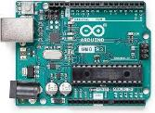
Droplet Video Acquisition
Develop a waveform tuning procedure to dispense single droplets
Setup
Syringe
Nozzle
High Voltage Amplifier (20x)
AWG
Set Waveform
Trigger Waveform
Trigger Camera
PC
Trigger Arduino
Lighting
Export Video and Reset Camera

Slide 18
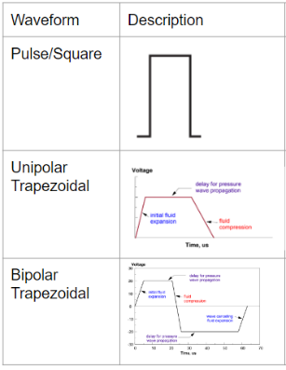
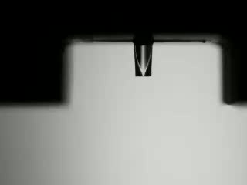
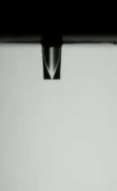

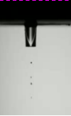
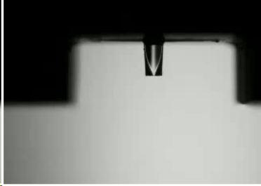

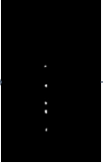
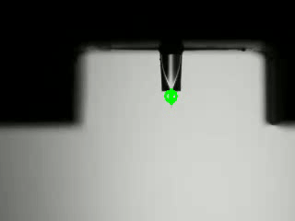




Droplet Video Analysis
Main Objectives:
Waveform
Automate acquisition and post-processing of droplet videos (Droplet Tuning Workflow)
Determine waveform, voltage amplitude, and pulse width settings that provide single droplets
Voltage Amplitude
Pulse Width
Droplet Counting Pipeline
Background Subtraction
Binarize
Draw Contours on Original Image
Microfab suggested settings
Subtract
Droplet Number Results:
Conclusions:
Dwell Time and Voltage Amplitude together play a role in droplet tuning
Droplet tuning workflow effectively counts the number of droplets
Workflow can be used to tune waveform for new “inks”
1
1
Dwell Time (us)
Dwell Time (us)
1
1
1
1
1
1
1
1
1
1
AWG Voltage Amplitude (V)
AWG Voltage Amplitude (V)
Bipolar
Unipolar
1
Notes:
Trapezoidal Waveforms have rise times of 3 us while pulse have rise times of 1 us

Slide 19



Initial Single Nozzle System
Issues:
Messy wiring with many weak, non-shielded, and fragile connections
Nozzle and camera holders were susceptible to moving when touched
Required DC Power Supply to light LED Array
Placement of nozzle could only print on a single chip in the 4 chip holder
Device positions not completely fixed due to use of tape

Slide 20




New 8 Nozzle System
Features:
Wiring is secure
Accommodates up to 8 nozzles
Includes 8 nozzle multiplexing PCB
Power system for LED Array and multiplexing PCB
Nozzles and top camera positions are secured
Devices positions secured using optical breadboard
Nozzles and camera placed to cover all 4 chips

Slide 21




Fluorescent ANT V3 On-Chip Printing
Fluoro-Max Green and Red Dry Fluorescent Particles
Results
Maximum Inaccuracy: 150 um
7/64 Ring Resonator completely covered
13/64 Ring Resonators partially covered
Goat anti-Mouse IgG (H+L), Superclonal™ Recombinant Secondary Antibody, Alexa Fluor™ 555, Invitrogen™
Results
Maximum Inaccuracy: 150 um
Satellite droplets present during printing

Slide 22
TRIUMF - TITAN
January 2022 - June 2022
Supervisors: Dr. Ania Kwiatkowski

Slide 23





Aims of Mass Spectroscopy
Precision Mass Measurements to gain a deeper understanding of atomic structure
- Using Relativity and sub-atomic particle masses to determine binding energy
Atomic Mass = Mass of Protons + Mass of Neutrons + Mass of Electrons - m
Re-arrange

Slide 24


Multi-Reflection Time of Flight Mass Spectrometry (MR-ToF -MS)
MagneToF Detector
Ion mirror 2
MRS
Ion Source
Ion mirror 1
Injection Trap

Slide 25




Mass Range Selector (MRS)
Blocking Voltage ~ 130 V
Passing Voltage - Ground
MRS Electrode Voltage vs. Time
Mass Range Selector (MRS): Uses High and Low voltages to filter ions
Duty Cycle: The percentage for which the MRS is off
Demo 2
MR-ToF Analyzer
Demo 1

Slide 26


Goal: Dual Species Isolation
Purpose:
- Determine the presence of two species with different masses
-Measure the mass of two species
- Dual Species Beam Purification
AND
Demo 3
Notes:
Shrink Waveforms and line up on right side, Why at back with analogy

Slide 27



Problems
1. The normalized deflecting time, N, plays a large role in cleaning and isolation effectiveness.
2. Minimum Pulse Time can be as small as 4ns whereas switches can switch between voltages at 50-100 ns
Notes:
Change all blocking to deflecting

Slide 28




Solution: Simulation
Mass Pair Scans
Minimum Pulse Time
Normalized Deflecting Time
MRS DSI Simulator

Slide 29
Signal Testing
FPGA:
- Waveform clipping at Pulse Time smaller than 50 ns
Pulser:
- Pulse Times smaller than 50 ns are removed
- Waveform clipping at Pulse Time between 50 ns and 200 ns
Trigger System
FPGA
Pulser
MRS Electrode

Slide 30




Conclusion
MRS Dual Species Isolation was successfully implemented and increased capabilities in beam purification and mass measurement

Slide 31
Bootstrapped H-Bridge DC Motor Driver Design
June 2022

Slide 32

H-Bridge Bootstrap Circuit
By Jaden Sequeira
Notes >>

Slide 33


Notes
Operating PWM Frequency
Working Frequency (optimal): 50 – 300 Hz
Higher Frequencies (>300 Hz) result in torque loss
Lower Frequencies (<50 Hz) result in buckling at lower duty cycles (i.e. 50%)
Power
+10V can be replaced with +15V (LiPo)
+10V suggested for initial gate drive signal testing
Functional with LiPo 16.8V max voltage

Slide 34







Bootstrap Design Overview
Bootstrap design ensures Q1 gate is 10 V above source voltage (Q1 is conducting) when the input signal (Q5 gate) is Hi
When input signal (Q5 gate) is Lo, Q1 gate is pulled down to ground (Q1 is non-conducting)

